Slide 1
Think Tank for the Intersection of Linguistic Research and Augmentative and Alternative Communication (AAC) Pittsburgh, Pennsylvania August 8-9, 2011
Carol L. Tenny
Semantic Compaction Systems
Katharine J. Hill
University of Pittsburgh

Slide 2
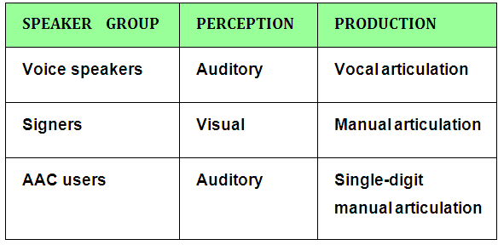
Think Tank for the Intersection of Linguistic Research and AAC Tenny and Hill
August 8-9, 2011 Pittsburgh, Pennsylvania
1. Introduction: A special population of language speakers
Compare three speaker groups by their perception and production modalities:
Can we learn something about the relation between a modality-independent abstract grammar, and the modality-dependent components of language?

Slide 3
Think Tank for the Intersection of Linguistic Research and AAC Tenny and Hill
August 8-9, 2011 Pittsburgh, Pennsylvania
1. Introduction: About our speakers
20 Minspeak (AAC) language system users, cognitively normal, not aphasic, only impaired in the motor production of speech
Native English speakers
Diagnosed with cerebral palsy
Mean age: 30 years
Gender: 15 men, 5 women
Education: 19 have some college experience or degree
Employment: 13 have part or full-time employment
Avge time on their AAC devices: 5 years
Avge Communication Rate: 12 wpm. (Range : 4.1-22.0 wpm)
(NOTE: Normal speakers estimated at avge 150 wpm)

Slide 4
Think Tank for the Intersection of Linguistic Research and AAC Tenny and Hill
August 8-9, 2011 Pittsburgh, Pennsylvania
1. Introduction: About our transcripts
Interviews – dyadic conversations
Language activity monitor (LAM) recorded log files
Log files used to generate transcripts
Manual annotation: 96% inter-rater reliability

Slide 5
Think Tank for the Intersection of Linguistic Research and AAC Tenny and Hill
August 8-9, 2011 Pittsburgh, Pennsylvania
1. Introduction: About our speakers and transcripts.
An excerpt from a transcript shows normal grammatical competence
I have a really nice little home which I rent with the option to buy someday, but it's in a nice neighborhood.
No, it's just me and old O--- my dog that is.
high school.
I'm planning {jj} [er:spe] [bks] to go to college here someday hopefully.
I've been saying that for a couple years.
I need to just do it.
I help do trainings with V--- then I sit on a couple
{a} [er:sem] [bks] state {board} [er:sem] [bks] {boader} [er:spe] [bks] boards for the disabled.
It'll be a year October since I've started.

Slide 6
Think Tank for the Intersection of Linguistic Research and AAC Tenny and Hill
August 8-9, 2011 Pittsburgh, Pennsylvania
1. Introduction: About our speakers and transcripts.
An excerpt from a transcript shows normal grammatical competence
I have a really nice little home which I rent with the option to buy someday, but it's in a nice neighborhood.
No, it's just me and old O--- my dog that is.
high school.
I'm planning {jj} [er:spe] [bks] to go to college here someday hopefully.
I've been saying that for a couple years.
I need to just do it.
I help do trainings with V--- then I sit on a couple
{a} [er:sem] [bks] state {board} [er:sem] [bks] {boader} [er:spe] [bks] boards for the disabled.
It'll be a year October since I've started.

Slide 7
Think Tank for the Intersection of Linguistic Research and AAC Tenny and Hill
August 8-9, 2011 Pittsburgh, Pennsylvania
1. Introduction: A Preview of our Speech Error Findings
We can distinguish two kinds of errors, which we characterize as:
Morphological
Articulatory (Phonetic)

Slide 8
Think Tank for the Intersection of Linguistic Research and AAC Tenny and Hill
August 8-9, 2011 Pittsburgh, Pennsylvania
2. The language representation system: Minspeak
A keyboard with grammar keys (G) and
lexical keys (L).
Icons/pictures on the lexical keys are used for meaning, (but no semantic compositionality is claimed or maintained).
The user hits a sequence of keys. Coded sequences of keys represent words.
Coded sequences generally begin or end in a grammar key.
The words appear on the screen for the speaker to read.

Slide 9
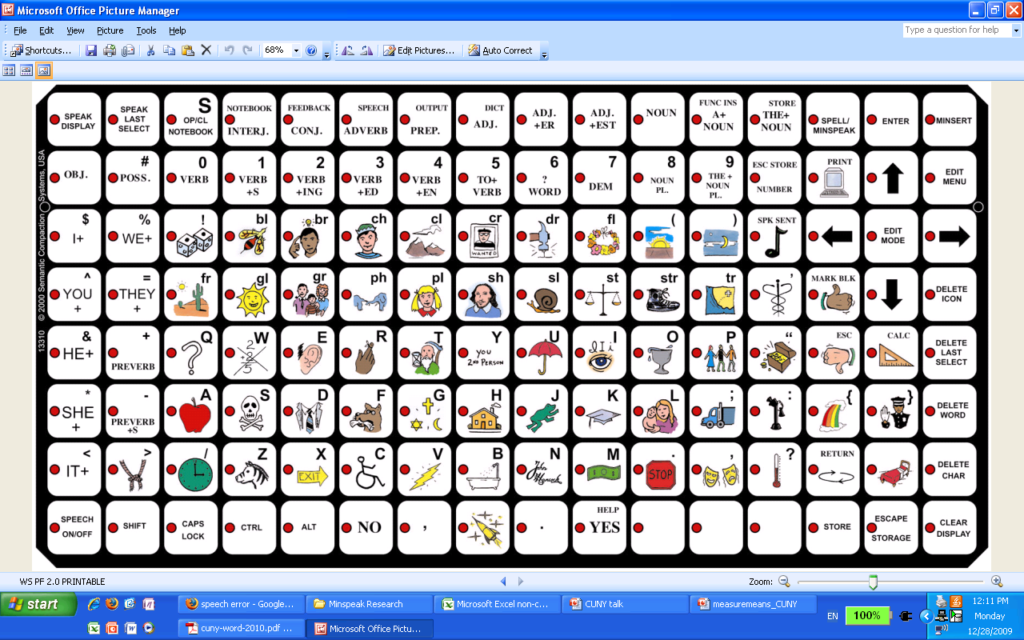
Think Tank for the Intersection of Linguistic Research and AAC Tenny and Hill
August 8-9, 2011 Pittsburgh, Pennsylvania
2. The language representation system: Minspeak
doctor: PEOPLE_MEDICAL_NOUN

Slide 10
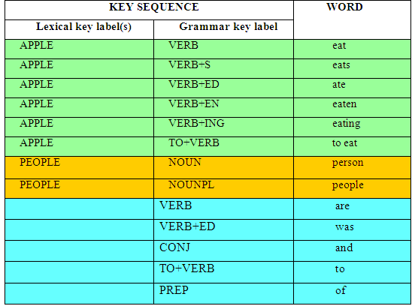
Think Tank for the Intersection of Linguistic Research and AAC Tenny and Hill
August 8-9, 2011 Pittsburgh, Pennsylvania
2. The language representation system: Minspeak
Excerpt from a Minspeak dictionary showing some morphological variants and some single-key codings (Patterns LG, G):

Slide 11
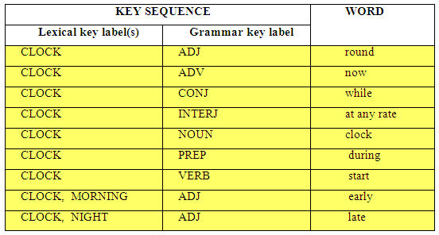
Think Tank for the Intersection of Linguistic Research and AAC Tenny and Hill
August 8-9, 2011 Pittsburgh, Pennsylvania
2. The language representation system: Minspeak
We can see a rudimentary morphology in Minspeak.
Excerpt from a Minspeak dictionary showing different parts of speech (Patterns LG, LLG)

Slide 12
Think Tank for the Intersection of Linguistic Research and AAC Tenny and Hill
August 8-9, 2011 Pittsburgh, Pennsylvania
2. The language representation system: a spelling option
The lexical keys also contain orthographic letters.
In spelling mode the speaker hits a sequence of keys referring to the letters on them.
The words appear on the screen for the speaker to read.

Slide 13
Think Tank for the Intersection of Linguistic Research and AAC Tenny and Hill
August 8-9, 2011 Pittsburgh, Pennsylvania
2. The language representation systems: a spelling mode
cup: C U_ P

Slide 14
Think Tank for the Intersection of Linguistic Research and AAC Tenny and Hill
August 8-9, 2011 Pittsburgh, Pennsylvania
2. The language representation system: Speech production and error correction
The user may choose to correct words as they appear on the screen.
Some choose to backspace over the errors and put in the corrected word; some do not. We ignored whether or not they backspaced to erase their errors.
The user decides when to hit the key to launch speech synthesis.
The errors and corrections made in this gap between motor production and speech output are recorded in our data.

Slide 15
Think Tank for the Intersection of Linguistic Research and AAC Tenny and Hill
August 8-9, 2011 Pittsburgh, Pennsylvania
2. The language representation system
The most basic units in a Minspeak-AAC device, and loose corollaries with established linguistic units.

Slide 16
Think Tank for the Intersection of Linguistic Research and AAC Tenny and Hill
August 8-9, 2011 Pittsburgh, Pennsylvania
3. Speech errors: They reflect language constraints
Vocally articulating speakers make speech errors reflecting constraints of the language (Fromkin 1973, others). Grammar and lexical morphemes are replaced by morphemes of the same type:
and so in conclusion →and so in concludement naturalness → nationalness
We have similar examples, but what kind of errors are these? It is difficult to tell.

Slide 17
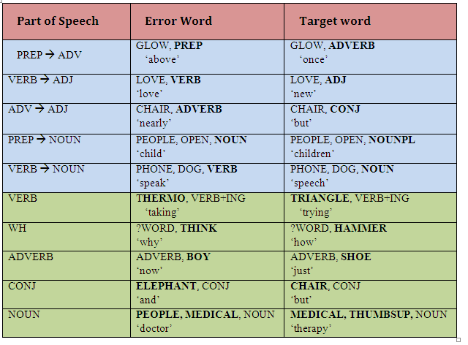
Think Tank for the Intersection of Linguistic Research and AAC Tenny and Hill
August 8-9, 2011 Pittsburgh, Pennsylvania
3. Speech error data: Morphological errors in Minspeak mode
AAC speech errors showing grammar morphemes replaced by grammar morphemes, and lexical morphemes are of the same type:

Slide 18
Think Tank for the Intersection of Linguistic Research and AAC Tenny and Hill
August 8-9, 2011 Pittsburgh, Pennsylvania
3. Speech error data: Morphological errors in Minspeak mode
Difficulties:
We cannot tell if these errors are ‘morpheme’ errors.
In Minspeak only actual words can be produced, so we cannot see errors that produce new word-forms.
Lack of keystroke tracking data.
Since Minspeak is designed to be as cost-efficient as possible in terms of minimizing keystrokes, many words are two-keystroke words, in which the morpheme and the segment are identical. Because of this design factor, we have a paucity of sub-lexical structure to examine.

Slide 19
Think Tank for the Intersection of Linguistic Research and AAC Tenny and Hill
August 8-9, 2011 Pittsburgh, Pennsylvania
3. Speech error data: Morphological errors in Minspeak mode
Approaches: We can look at general structure preservation of morphological form in the speech errors.
What proportion of errors preserve number of keystrokes?
What proportion of errors preserve general morphological structure of lexical and grammatical morphemes?

Slide 20
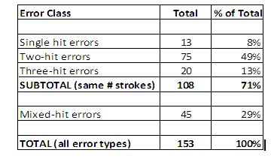
Think Tank for the Intersection of Linguistic Research and AAC Tenny and Hill
August 8-9, 2011 Pittsburgh, Pennsylvania
3. Speech error data: Morphological errors in Minspeak mode
Approaches: We can look at general structure preservation of morphological form in the speech errors.
What proportion of errors preserve number of keystrokes?
71%
What proportion of errors preserve general morphological structure of lexical and grammatical morphemes?

Slide 21
Think Tank for the Intersection of Linguistic Research and AAC Tenny and Hill
August 8-9, 2011 Pittsburgh, Pennsylvania
3. Speech error data: Morphological errors in Minspeak mode
2. What proportion of errors preserve general morphological structure of lexical and grammatical morphemes?

Slide 22
Think Tank for the Intersection of Linguistic Research and AAC Tenny and Hill
August 8-9, 2011 Pittsburgh, Pennsylvania
3. Speech error data: Morphological errors in Minspeak mode
2. What proportion of errors preserve general morphological structure of lexical and grammatical morphemes?
Error-target pairs with the same number of keystrokes in error and target words, classified by number of keystrokes and arrangement of grammar (G) and lexical (L) keys:

Slide 23
Think Tank for the Intersection of Linguistic Research and AAC Tenny and Hill
August 8-9, 2011 Pittsburgh, Pennsylvania
3. Speech error data: Morphological errors in Minspeak mode
2. What proportion of errors preserve general morphological structure of lexical and grammatical morphemes?
Error-target pairs with the same number of keystrokes in error and target words, classified by number of keystrokes and arrangement of grammar (G) and lexical (L) keys:
69% of all analyzable errors (105/153)
97% of errors preserving number of keystrokes (105/108)
66% of all analyzable errors not counting single- hits (93/140)
98% of errors preserving number of keystrokes not counting single-hits (93/95)

Slide 24
Think Tank for the Intersection of Linguistic Research and AAC Tenny and Hill
August 8-9, 2011 Pittsburgh, Pennsylvania
3. Speech error data: Morphological errors in Minspeak mode
Preliminary Conclusions
A bias towards preservation of general morphological structure of lexical and grammatical keys:
1. Bias towards preserving number of keystrokes
2. Bias towards preserving general morphological structure of lexical and grammatical keys
Statistical evaluation: Assuming 50% as unbiased, Confidence Interval for 71% here as being biased:
Test of p = 0.5 vs p not = 0.5
Sample X N Sample p 95% CI Exact P-Value
1 108 153 0.705882 (0.626901, 0.776698) 0.000

Slide 25
Think Tank for the Intersection of Linguistic Research and AAC Tenny and Hill
August 8-9, 2011 Pittsburgh, Pennsylvania
4. Speech error data: Spelling mode errors show us the effect of adjacency
We can look at spelling errors from a purely articulatory point of view; adjacency relations are a factor in errors.
crazy → crazt

Slide 26
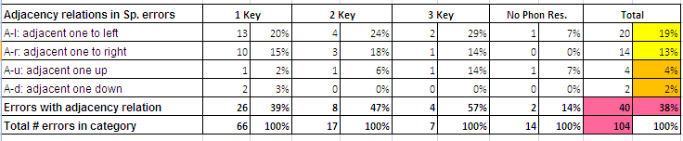
Think Tank for the Intersection of Linguistic Research and AAC Tenny and Hill
August 8-9, 2011 Pittsburgh, Pennsylvania
4. Speech error data: Spelling mode errors show us the effect of adjacency
Observation 1: 40/104 = 38% are errors involving some adjacency relation.
Observation 2: More left-right errors (32%) than up-down errors (6)%.
Chart below shows proportion of errors in spelling mode which can be described as adjacency errors.

Slide 27
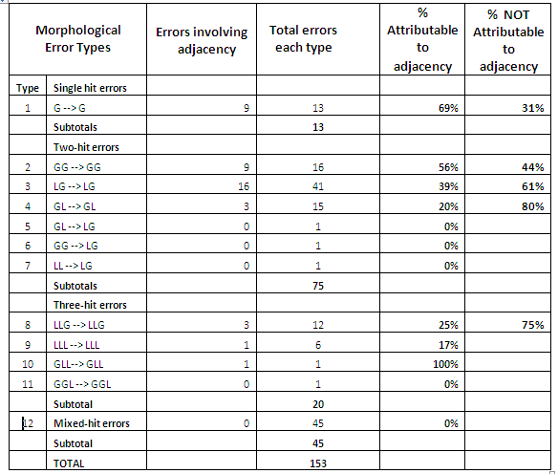
Think Tank for the Intersection of Linguistic Research and AAC Tenny and Hill
August 8-9, 2011 Pittsburgh, Pennsylvania
4. Speech error data: Back to Minspeak mode
Adjacency is also a factor in Minspeak errors, but doesn’t account for all errors.

Slide 28
Think Tank for the Intersection of Linguistic Research and AAC Tenny and Hill
August 8-9, 2011 Pittsburgh, Pennsylvania
5. Speech error data: No errors reflecting ‘phonology’
Vocally articulating speakers make phonological errors in word production, by mixing up words with similar phonology (Fromkin 1973):
“bottom of page 5”→ “bottle of page 5”
“infinitive clauses” → “infinity clauses”
“an ice cream cone” → “a kice ream cone”
Our AAC Minspeak users DID NOT produce these errors. We only have examples such as (e.g.,):
‘children’ → ‘child’
PEOPLE_OPEN_NOUNPL → PEOPLE_OPEN_NOUN
‘started’ → ‘starting’
WATCH_VERBING → WATCH_VERBED

Slide 29
Think Tank for the Intersection of Linguistic Research and AAC Tenny and Hill
August 8-9, 2011 Pittsburgh, Pennsylvania
5. Speech error data: No errors reflecting ‘phonology’
We have some errors in spelling mode, without competing adjacency or repeat-hit effects:
a. {scrim} [er:spe] scream [spe]
b. {croford}[er:spe] Crawford [spe]
c. {opportunitity}[er:spe][bks] opportunity
Creative speakers, however, can reference some acoustic analysis to manipulate or simplify their production in symbolic mode.
Vinson et al (2009) observe that BSL speakers employ different channels for language production by symbolic and mouthing modes.

Slide 30
Think Tank for the Intersection of Linguistic Research and AAC Tenny and Hill
August 8-9, 2011 Pittsburgh, Pennsylvania
5. Interim Summary
We can identify two kinds of speech errors among our AAC users:
We have errors influenced by the morphology of the production forms.
We have errors influenced by the physical logistics (phonetics) of single-digit articulation.
We do not have errors reflecting auditory phonology.
Speech errors of AAC users seem to reflect the morpho-phonetics of word-forms for their production only; and not word-forms for perception.

Slide 31
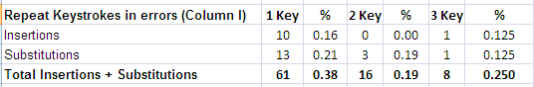
Think Tank for the Intersection of Linguistic Research and AAC Tenny and Hill
August 8-9, 2011 Pittsburgh, Pennsylvania
6. Errors with Repeat Hits
Repeated keystrokes as a factor in insertion and substitution errors:
’rose’ → ’roose’
Phonetics: or phonemics?
Is repeating the same hit physically and computationally easier than moving to new location and hitting a different key?

Slide 32
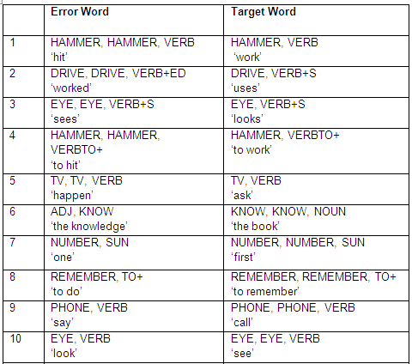
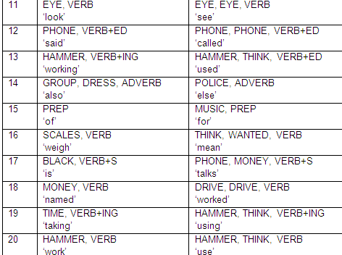
Think Tank for the Intersection of Linguistic Research and AAC Tenny and Hill
August 8-9, 2011 Pittsburgh, Pennsylvania
6. Errors with Repeat Hits
Repeated keystrokes also a factor in Minspeak errors.
Double-hits on the same key in speech errors with mixed number of hits:

Slide 33
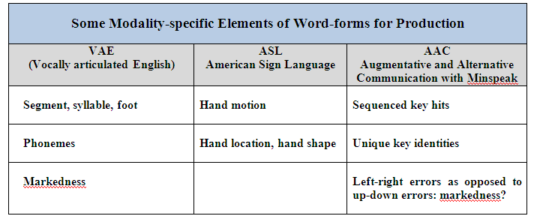
Think Tank for the Intersection of Linguistic Research and AAC Tenny and Hill
August 8-9, 2011 Pittsburgh, Pennsylvania
7. Questions and More Thoughts
How are AAC speakers like ASL speakers and vocal articulators in their language production?; how are they different?

Slide 34
Think Tank for the Intersection of Linguistic Research and AAC Tenny and Hill
August 8-9, 2011 Pittsburgh, Pennsylvania
7. Questions and More Thoughts
What can we say about the relation between production and perception word-forms?
What is the role of word frequency?
What aspects of word-forms for production are part of language-specific endowment as opposed to language modality? – perhaps repeating signal?
Are there distinctive features for AAC production?
What is the role of the visual feedback?
And more questions…

Slide 35
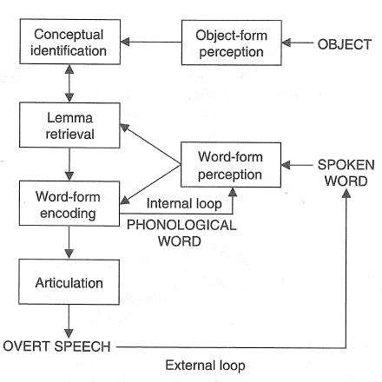
Think Tank for the Intersection of Linguistic Research and AAC Tenny and Hill
August 8-9, 2011 Pittsburgh, Pennsylvania
7. Questions and More Thoughts
What can we say about relation between production and perception word forms? A model of language production distinguishing word forms for perception and production:
No internal loop inherent or necessary.
Flow of information in the WEAVER++ model of language production, monitoring, and processing (Roelofs 2005)

Slide 36
Think Tank for the Intersection of Linguistic Research and AAC Tenny and Hill
August 8-9, 2011 Pittsburgh, Pennsylvania
More Thoughts: Distinctive features?
Each key has a unique identity, defined by:
Location in two dim.: [12A,5D] [13A,4D] [11A,1D]
Unique icon identity: PEOPLE [P] MEDICAL [,] NOUN

Slide 37
Think Tank for the Intersection of Linguistic Research and AAC Tenny and Hill
August 8-9, 2011 Pittsburgh, Pennsylvania
References
Blevins, J. (2004). Evolutionary phonology: The emergence of sound patterns. Cambridge: Cambridge University Press.
Hartsuiker, R. J. , R. Bastiaanse, A. Postma & F. Wijnen (Eds.) (2005) Phonological encoding and monitoring in normal and pathological speech. New York: Psychology Press.
Hayes,B., Kirchner, R., Steriade, D.(Eds.) (2004) Phonetically Based Phonology. Cambridge: Cambridge University Press.
Levelt, W. J. M., Roelofs, A.. & Meyer, A. S. (1999). A theory of lexical access in speech production. Behavioral and Brain Sciences, 22, 61-75.
Leuninger, Helen, Hohenberger, Annette, Waleschkowski, Eva, Menges, Elke, and Daniela Happ. 2004. The impact of modality on language production: evidence from slips of the tongue and hand. In Interdisciplinary Approaches to Language Production, ed. by Thomas Pechman and Christopher Habel, 219–277. Berlin and New York: Mouton de Gruyter.
MacWhinney, B. (2005). The emergence of linguistic forms in times. Connection Science, 17:3-4, 191-211.
Roelofs, A. (2005). Spoken word planning, comprehending, and self-monitoring: Evaluation of WEAVER++. In R. J. Hartsuiker, R. Bastiaanse, A. Postma & F. Wijnen (Eds.), Phonological encoding and monitoring in normal and pathological speech. New York: Psychology Press.
Vinson, D. P., Thompson, R., Skinner, R., Fox, N. & Vigliocco, G. (2009). The hands and mouth do not always slip together in British Sign Language: Dissociating articulatory channels in the lexicon. CogSci 2009 Proceedings.
Wilson, M. and Emmorey, K. (2006). Comparing Sign Language and Speech Reveals a Universal Limit on Short-Term Memory Capacity. Psychological Science, 17: 682-683,

Slide 38
Think Tank for the Intersection of Linguistic Research and AAC Tenny and Hill
August 8-9, 2011 Pittsburgh, Pennsylvania
Contact Information
tenny@linguist.org
khill@pitt.edu

Slide 39
Think Tank for the Intersection of Linguistic Research and AAC Tenny and Hill
August 8-9, 2011 Pittsburgh, Pennsylvania
The End

