Slide 1
Linguistic and Computational Aspects of Language Representations for AAC
Eric Nyberg
Carnegie Mellon University

Slide 2
Definitions
Language Encoding:
  Sequences of elements (e.g. key strokes) which map to language units (e.g. morphemes, words, phrases, sentences, …)
Language Device: a physical presentation (e.g. layout) which provides:
  a means for the user to (learn, retain, ..) navigate through and select from the set of available elements
  speech output for the selected language units

Slide 3
Science of Encoding and Device Design
Coverage: What language units should be included?
-> “What we want to say”
Complexity: How should they be encoded as sequences of elements?
Interface: How should language units be arranged in the layout?
-> “Saying it as fast as we can”
Evaluation: How can we measure the utility (coverage, efficiency) of a particular encoding and layout?

Slide 4
Accessing Language with Symbols
In AAC devices (both electronic and non-electronic), a user makes one or more selections (button push, finger point, etc.) to access a language unit (word, phrase, pre-stored sentence, etc.)
Research Questions:
  How can multiple symbols be combined to access a single language unit? (symbol system).
  How can we compare single-selection and multi-selection symbol systems?

Slide 5
Single- vs. Multi-Symbol Selections
Single symbol selections
  Easy to learn: one symbol per language unit
  Hard to extend: adding a language unit requires adding a new symbol
Multi-symbol selections
  A little more effort to learn: multiple symbols per language unit, with rationales for combination
  Easier to extend: existing symbols can be recombined to access new language units
Can we simultaneously reduce the size of the selection set while keeping the selection length short and easy to learn and retain?

Slide 6
Example 1
Coverage: Commonly spoken sentences
Complexity: One keystroke per sentence
Evaluation: Average time to speak a sentence
PRO: Only actuation per utterance!
CON:
  Limited flexibility
  Limited scalability (every sentence requires a new key)

Slide 7
Example 2
Coverage: Commonly spoken words
Complexity: One keystroke per word
Evaluation: Average time to speak a word
PRO:
  Only keystroke per word!
  More flexibility (can make unique sentences)
CON:
  Limited scalability (every word requires a new key)

Slide 8
Example 3
Coverage: Commonly spoken words
Complexity: >1 keystroke per word
Evaluation: Average time to speak a word
PRO:
  More flexibility (can make unique sentences)
  More scalability (new words from existing keys)
CON:
  More keystrokes per word

Slide 9
Design Tradeoffs
Example goal: effective access to n words
Compare:
  A 1D layout ( width n )
    Required for sequential selection
  A 2D layout ( width X height = n )
Layout A
1
2
3
4
5
6
7
8
9
10
11
12
13
14
15
16
Layout B
1
2
3
4
5
6
7
8
9
10
11
12
13
14
15
16

Slide 10
Layout A
1
2
3
4
5
6
7
8
9
10
11
12
13
14
15
16
Layout B
1
2
3
4
Encoding One
Layout A
Layout B
5
6
7
8
press
press
press
press
9
10
11
12
the = < 1 , 2 >
move
move
13
14
15
16
press
press
press
press
a = < 1 , 6 >
move
move
freq
press
press
press
an = < 1 , 5 >
move
move
press
the
a
an …
words
Motor planning: # strokes per element vs. selection method vs. layout

Slide 11
Single Selection vs. Multi-Selection
1
2
3
4
5
6
7
8
Single selection: 16 words
Two-selection: 16 x 16 = 256 words
Three-selection: 16 x 16 x 16 = 4096 words
9
10
11
12
13
14
15
16
What’s the best layout for the client? If motor planning and execution are not a problem, then a large layout with multiple selections per element might be ok; if motor planning and execution are difficult, then a compact layout with limited selections per element may be necessary.

Slide 12
Linguistic Structure of Elements
Run,
Runs,
Ran,
Running, …
1
2
3
1
2
1
2
4
1
3
1
2
5
1
4
1
2
6
1
5
Select
morpheme
Select
surface form
Select
each surface
form directly
Easier to learn, retain,
access; same sequence
for each morpheme, same
key for each surface form
More difficult to learn, retain,
access; unique sequence for
each surface form

Slide 13
Three Types of Semantic Encoding Widely Used in AAC
The three types of semantic encoding approaches to be discussed here are:
Type 1) semantic encoding with no defined elements and an indefinite total number of symbols (PCS, Widget Symbols, Imagine Symbols™, Symbolstix, Tech/Syms™, etc).
Type 2) semantic encoding with a defined and restricted number of elements but an indefinite total number of possible symbols (Blissymbolics©, DynaSyms®, PicSyms©, or outside the field of AAC, Mandarin Chinese Writing)
Type 3) semantic encoding using a restricted number of symbols that recombine (Chang, et al., 1992) to provide an indefinite number of total coded units (Unity®, LLL™, Deutsche Wortstrategie™, Words Strategy Français™)
13

Slide 14
Type 1 - Semantic Encoding: no defined elements, an indefinite total number of symbols (PCS, Symbolstix ®, etc)
Type 1 encodings strive for high iconicity – transparency or high translucency
Some words are picture producers and some words are not (Schank and Abelson, 1977)
Words that are picture producers are typically simple action verbs – “kiss” and physical objects – “toaster”
Common verbs such as “need” are difficult to represent transparently
Many common nouns, e.g., “trouble” cannot be represented transparently with a single symbol
Type 1 encoding approaches often have many thousands of symbols and can add new symbols at any time
Type 1 encoding approaches combat the large number of symbols by arranging symbols on grids which can be navigated through to find the desired symbol -- this is sometimes called Dynamic Displays

Slide 15
Type 1 Semantic Encoding (cont.)
Type 1 symbol collections deemphasize high-frequency (core) vocabulary because of the infrequency of picture-producing words in the 400 most common lexemes in NL (Hill, 2001)
Type 1 focuses on extended vocabulary with its large collections of nouns designating physical objects
Non-picture producing vocabulary deemed necessary are represented by symbols of low translucency and sounds-like strategies with additional phonetic labels to guide instructors
Type 1 symbol collections rarely stress any aspect of NL structure beyond nouns – e.g. syntax or morphology -- and are large, 3,000 plus
The guiding organizational feature is the likeness of the symbols to the words or phrases represented
When a new word, idea, phrase, or function is added, a new symbol is required
15

Slide 16
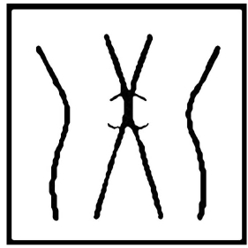
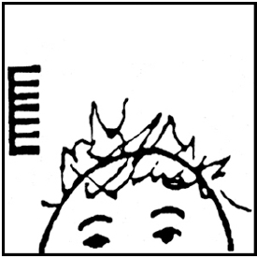
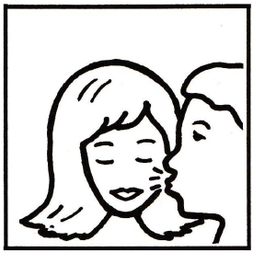
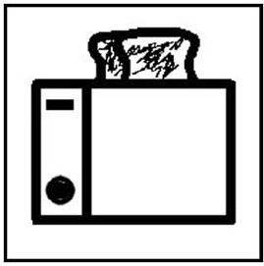
Type 1 - Semantic Encoding: no defined elements and an indefinite total number of symbols (PCS, Widget Symbols, Imagine Symbols™, Symbolstix, Tech/Syms™, etc)
Picture Communication Symbols (PCS™), 2006 is a language but not a Natural Language
The first two symbols are representations of the word “need”
Note the phonetic reference and the difficulty in achieving transparency
The second two symbols are of a transparent action “kiss” and a physical object “toaster”
Note the ease with which Type 1 symbol systems represent certain kinds of words but not others
16

Slide 17
Clinical Reasons to
Use Type 1 Symbol Sets
Type 1 has a one-to-one mapping from selection to language unit
Emphasis on recognizability allows picture-producing words to be a strong feature of early language boards
Large libraries typical of Type 1 symbols sets allow teachers and clinicians to draw from a wide range of vocabulary
Sophisticated graphic programs (e.g. Boardmaker) allow facilitators to redesign symbols for greater iconicity

Slide 18
Type 2 - semantic encoding: a defined and restricted number of elements; an indefinite total number of possible symbols (Blissymbolics©, DynaSyms®, or outside AAC, Chinese hanzi)
Type 2 encoding paradigms are often called systems, because they stress the relationship between and among the various code elements
A prime example of this approach to Natural Language representation comes from outside the field of AAC – the Chinese characters or “hanzi”
Mandarin Chinese has a limited number of stroke types and various constraints on the placement of these strokes
Phonetic elements penetrate individual hanzi frequently to produce a phonetic/semantic hybrid which obeys its own orders of placement
All elements of the surface structure of Mandarin are represented faithfully by the various hanzi
Iconic transparency is not a high goal in Mandarin hanzi, although many mnemonic rationales are used to teach the meaning behind the hanzi

Slide 19
Type 2 Semantic Encoding
Type 1 approaches are often called “symbol sets” because of the lack of relationship between and among the symbols
Type 2 encodings stress the relationship between and among the various code elements
Type 2 encodings formalize the relationship among the code elements to promote learnability
Type 2 encodings are almost never transparent but strive for certain helpful translucencies
Type 2 semantic encoding approaches need to add a new symbol for every new, coded unit
Type 2 semantic encoding approaches often have large symbol sets
19

Slide 20
Type 2 - Semantic Encoding: a defined and restricted number of elements but an indefinite total number of possible symbols (Blissymbolics©, PicSyms©, or outside the field of AAC, Mandarin Chinese)
山 峰 岭 峭 氵 洗 冲 冰
mountain (root)
peak
range
steep
water (root)
wash
flush
ice
Mandarin Hanzi are composed of a semantic root with varying phonetic elements

Slide 21
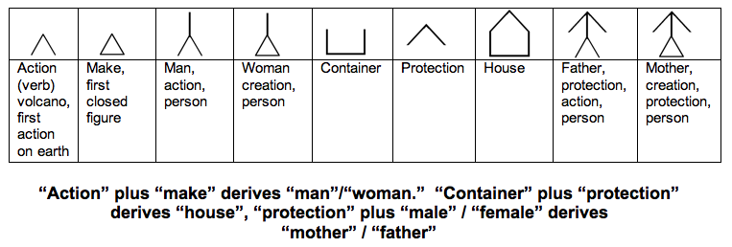
Type 2 Semantic Encoding Using Blissymbols
“Action” “make” “container” and “protection” are semantic primitives in the Bliss system
Blissymbols can be used to teach certain concepts
Blissymbolics is a language but not an NL

Slide 22
Complex Combinatorics Derive New Symbols
New symbols may be designed from existing primitives

Slide 23
Clinical Reasons for Using Type 2 Symbol Systems
Iconic elements allow teachers and clinicians to use patterns to teach natural language relationships
The systematicity of Type 2 symbol structures illustrates the rhyme and reason behind natural language and human thought
The focus on semantic primitives in Type 2 allows clinicians to leverage these primitives in their teaching paradigms

Slide 24
Type 3 - Semantic Encoding: restricted number of symbols that recombine to generate an indefinite total number of coded units (Unity®, LLL™, Deutsche Wortstrategie™)
Type 3 symbol systems use a restricted number of symbols which combine in sequences to represent an indefinite number of words and concepts of a natural language
The restricted number of symbols rarely exceeds 100 semantic and grammatical icons
Type 3 symbols combine with each other following a grammar. Unity® LLL™ Wortstrategie™ combine according to a grammar proposed by Baker, Schwartz, and Conti (1988)
Blissymbolics, and to a degree Mandarin, takes individual primitives to form an icon with translucent properties, type 3 symbol systems form short, rule-driven sequences to represent an indefinite number of words and concepts
Type 3 semantic encoding systems are distantly related to hieroglyphics and work simultaneously to reduce the number of symbols in a selection set and the number of symbols in a symbol string

Slide 25
Type 3 Semantic Encoding
Type 3 symbol systems generate very large numbers of self-actuating, two- and three-symbol unique sequences which can designate the semantic, syntactic, and morphologic elements of NL
The recombinant use of a relatively small number (100) of symbols in short sequences allows a single computer page on an AAC device to provide access to the whole core vocabulary, morphology, and syntax
Recombinant symbol use provides more than enough unique combinations to represent high frequency extended vocabulary

Slide 26
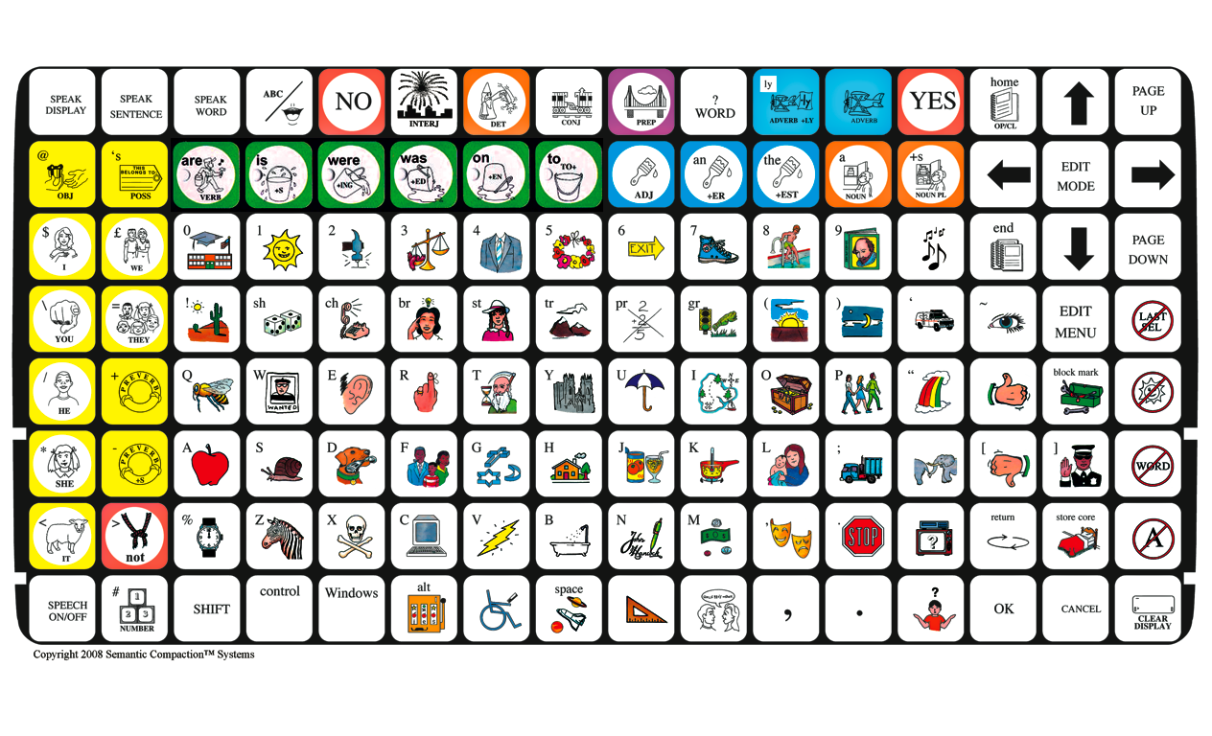
Type 3 Semantic Encoding -- Unity® 128 Keyboard
26

Slide 27
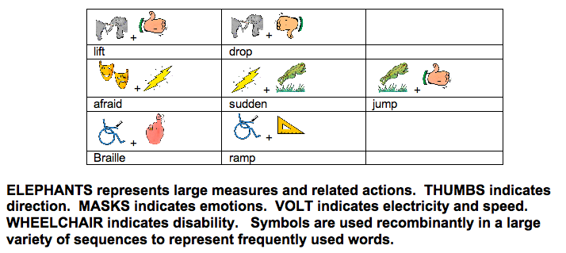
Semantic Encoding Using Unity® Symbols

Slide 28
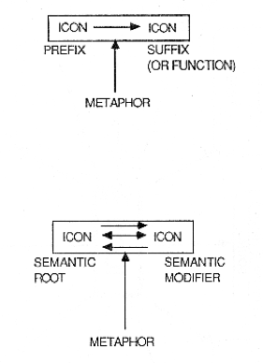
Type 3 Encoding Strategies: Structure of Symbol Sequence
Baker, Schwartz, Conti, 1990

Slide 29
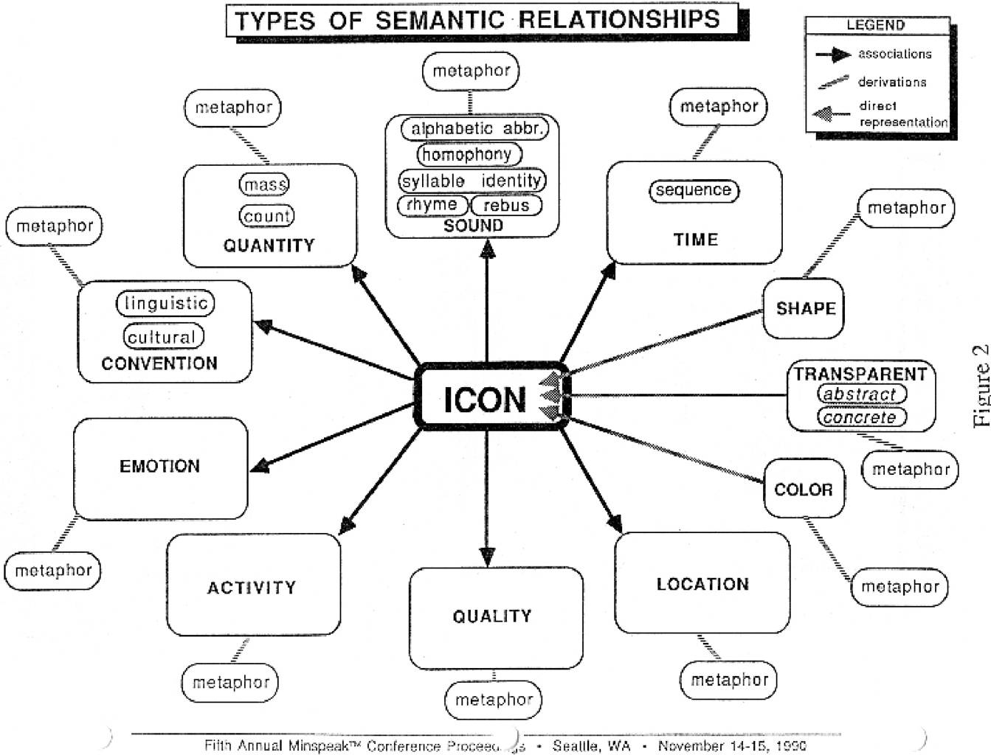
Type 3 Encoding Strategies: Combinatory Grammar
29

Slide 30
Comparative Example

Slide 31
Symbol Taxonomy by the New Systematic Typology
Type 1 | Type 2 | Type 3
Real objects Miniature objects Photographs Simple line drawings Picture Communication Symbols PCS Oakland Picture Dictionary Pictogram Ideogram Communication PIC Makaton® * Sigsymbols * Lingraphica Concept-Images American Sign Language | Yerkish Lexigrams PICSYMS Blissymbolics Pixon™ DynaSyms Sign Writing Premack Symbols Jet Era Glyphs (CyberGlyphs) | Unity® WordStrategy® Blissymbol Component Minspeak Word Strategy ® Swedish Blissymbol Component Minspeak™
 |  | Phonetic not semantic: Morse Code Aided Representation of Finger Spelling Traditional Orthography Braille Phonetic Alphabets

Slide 32
Reference
Baker, Lloyd, & Nyberg (2011). Clinical Implications of a Symbol Taxonomy for AAC – Electronic and Manual (presentation at CSUN)

